Slide 1
Basic Electrical Technology [ELE 1051]
Chapter 3 - Single Phase AC Circuits
(3.5)

Slide 2



















Power associated in RL load
For RL load:
$$Z$$
$$×I$$
$$V=IZ$$
$$X_{L}$$
$$V_{L}=I X_{L}$$
$$×I$$
$$S=I^{2}Z$$
$$Q=I^{2}X_{L}$$
$$θ$$
$$θ$$
$$θ$$
$$R$$
$$I$$
$$V_{R}=IR$$
$$P=I^{2}R$$
Impedance diagram
Phasor diagram
Power diagram
$$S=P+jQ$$
where,
S = Apparent Power (VA)
P = Active Power (W)
Q = Reactive Power (var)
$$S=\left|V\right|\left|I \right|$$
$$P=VI\cos{∅}$$
$$Q=VI\sin{∅}$$

Slide 3















Power associated in RC load
For RC load:
$$R$$
$$I$$
$$V_{R}=IR$$
$$P=I^{2}R$$
$$θ$$
$$θ$$
$$θ$$
$$×I$$
$$×I$$
$$Q=I^{2}X_{C}$$
$$X_{C}$$
$$V_{L}=I X_{C}$$
$$Z$$
$$V=IZ$$
$$S=I^{2}Z$$
Impedance diagram
Phasor diagram
Power diagram
$$S=P−jQ$$
Where,
S = Apparent Power (VA)
P = Active Power (W)
Q = Reactive Power (var)
$$S=\left|V\right|\left|I \right|$$
$$P=VI\cos{∅}$$
$$Q=VI\sin{∅}$$

Slide 4























Power in AC circuits
Power in AC circuit can be written as,
$$S=\left(\overline{V}\right)\left({\overline{I}}^{∗}\right)$$
$$Z=|Z|∠∅$$
$$S=VI(\cos{∅+j\sin{∅)}}$$
$$if \overline{V}=|V|∠0°$$
$$S=P+jQ$$
S - Apparent Power
Q – Reactive
Power
For RL Load
$$\overline{I}=\left|I\right|∠−∅$$
$$P=V_{rms}I_{rms}\cos{∅}$$
$$∅$$
$$I^{∗}=|I|∠∅$$
$$Q=V_{rms}I_{rms}\sin{∅}$$
P - Active Power
$$Z=\left|Z\right|∠−∅$$
$$S=VI(\cos{∅−j\sin{∅)}}$$
P - Active Power
$$if \overline{V}=|V|∠0°$$
$$S=P−jQ$$
$$∅$$
For RC Load
Q – Reactive
Power
$$\overline{I}=\left|I\right|∠∅$$
$$P=V_{rms}I_{rms}\cos{∅}$$
S - Apparent Power
$$I^{∗}=\left|I\right|∠−∅$$
$$Q=V_{rms}I_{rms}\sin{∅}$$
$$Apparent Power\left(S\right)$$
$$VA$$
$$Active Power\left(P\right)$$
$$W$$
$$Reactive Power\left(Q\right)$$
$$var$$
$$Units:$$

Slide 5
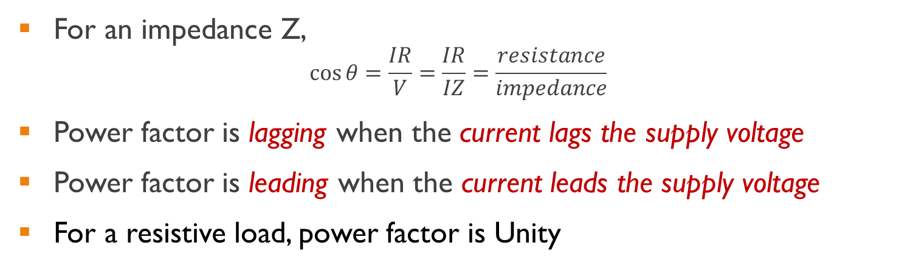
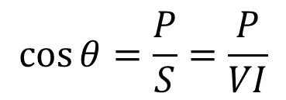
Power Factor
$$Power Factor=\frac{Active Power P in watts}{Apparent Power S in voltamperes}$$
$$\cos{θ}=\frac{P}{S}=\frac{P}{VI}$$
For an impedance Z,
$$\cos{θ}=\frac{IR}{V}=\frac{IR}{IZ}=\frac{resistance}{impedance}$$
Power factor is lagging when the current lags the supply voltage
Power factor is leading when the current leads the supply voltage
For a resistive load, power factor is Unity

Slide 6
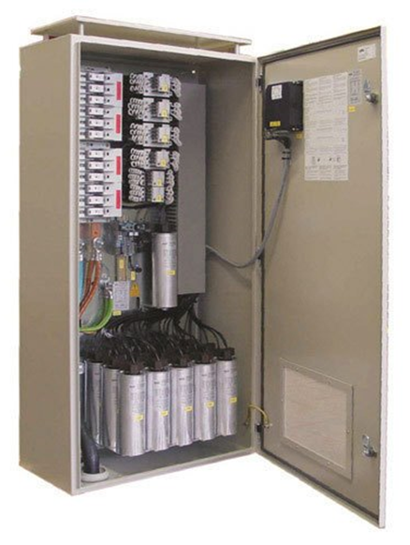
Disadvantages of Low Power Factor
Under utilisation of power system network
Increased transmission losses
Hence bulk consumers are advised to maintain the power factor close to unity by power utilities
Remedial Measures
Reactive power demand of Inductive loads can be compensated with capacitive loads
It is possible to localise reactive power requirement by connecting parallel capacitors across the load

Slide 7













Power Triangle
Practically, loads are in connected parallel
Majority of the loads are inductive in nature
$$S_{total}$$
$$S_{2}$$
$$Q_{2}$$
Load 2
A.C. Mains
Load 1
Load 2
$$∅_{2}$$
$$Q_{total}=Q_{1}+Q_{2}$$
$$S_{1}$$
$$P_{2}$$
$$∅_{TOTAL}$$
$$Q_{1}$$
$$∅_{1}$$
Load 1
$$P_{1}$$
$$S_{total}=P_{total}+{jQ}_{total}$$
$$P_{total}=P_{1}+P_{2}$$
http://www.kptcl.com/save.htm

Slide 8



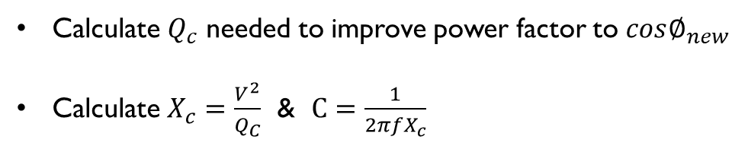








Power Factor Improvement
Connect capacitor parallel to the load
Energy stored by the capacitor provides the required reactive power by the load
$$S_{t}$$
$$S_{t}$$
$$Q_{c}$$
$$Q_{t}$$
$$S_{new}$$
A.C. Mains
Load 1
Load 2
capacitor
$$∅_{TOTAL}$$
$${Q_{new}=Q}_{t}−Q_{c}$$
$$∅_{TOTAL}$$
$$∅_{new}$$
$$P_{t}$$
$$P_{t}$$
Calculation of capacitor value
Calculate $Q_{c}$ needed to improve power factor to $cos∅_{new}$
Calculate $X_{c}=\frac{V^{2}}{Q_{C}}$ & $C=\frac{1}{{2πfX}_{c}}$

Slide 9

Illustration 1
A single-phase motor takes 8.3 A at a power factor of 0.866 lagging when connected to a 230 V, 50 Hz supply. Capacitance bank is now connected in parallel with the motor to raise the power factor to unity. Determine the capacitance value
$$C=57.43μF$$
Notes:
‘Huges Electrical & Electronic Technology’, 10th edition
Page No. 272, Exercise problem 1

Slide 10

Illustration 2
A single-phase load of 5 kW operates at a power factor of 0.6 lagging. It is proposed to improve this power factor to 0.95 lagging by connecting a capacitor across the load. Calculate the kvar rating of the capacitor
$$QC=5.023kVAR$$
Notes:
‘Huges Electrical & Electronic Technology’, 10th edition
Page No. 272, Exercise problem 2a

Slide 11
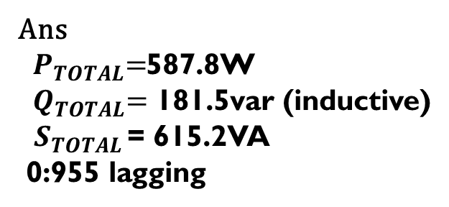
Illustration 3
Obtain the complete power triangle for three parallel-connected loads:
250VA, 0.5 p.f lagging
180W ,0.8 p.f leading
300VA,100 var (inductive)
Notes:
Parker Smith’s 500 solutions of problems in electrical engineering – solved by V. C. Natesan
Page No. 186, Problem 6.69

Slide 12

Thank You!

